Slide 1


Data Collection and Analysis Using SQL
Presented by:
Hemidov Ceyhun

Slide 2
Introduction
In this presentation, I will show how I collected and analyzed data using SQL.
You will learn about:
1
How I gathered the data
2
How I created data tables in SQL and imported the dataset
3
How I analyzed the data in SQL and drew meaningful conclusions
Without further delay, let’s get started!

Slide 3
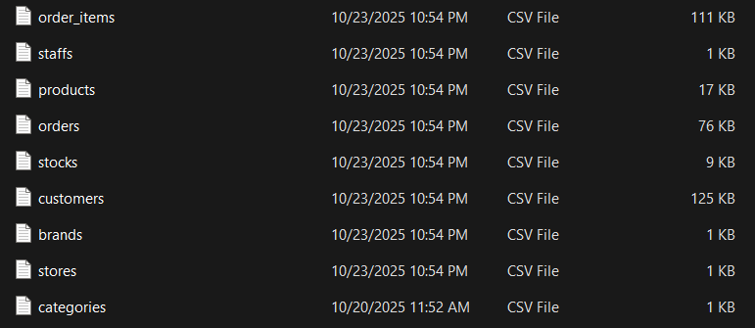
Data Preparation
In this project, we already have a certain dataset.
However, since all of the data is in CSV format, it cannot be directly analyzed in SQL.
Therefore, we need to import this data into the Valentina Studio program to make it ready for analysis.

Slide 4
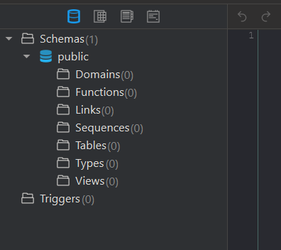
Creating Tables
As you can see here, there are no tables yet.
Therefore, we need to write the SQL code for each table separately and create them one by one.
After creating all the tables, we will be able to perform our analyses on these tables.

Slide 5
Let’s start to create all tables one by one

Slide 6
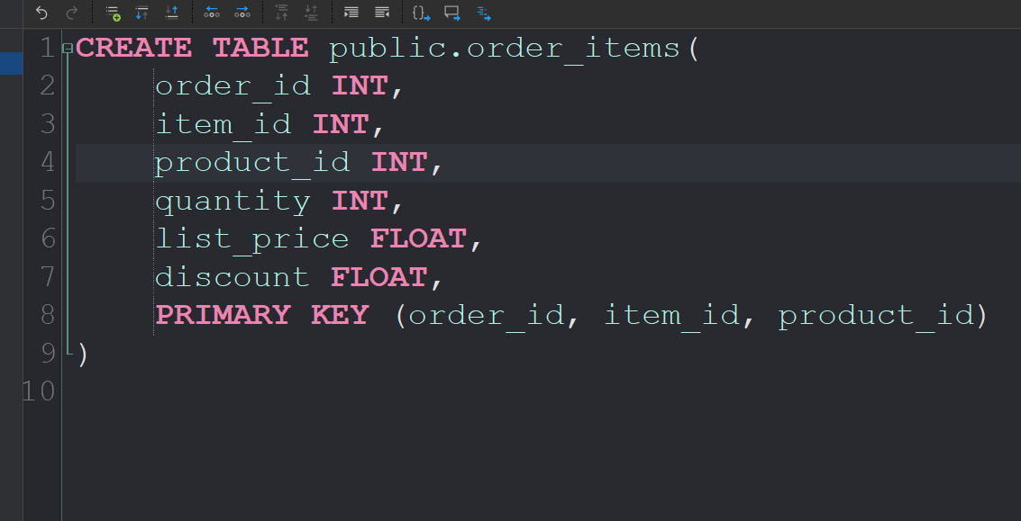
Order Items table
order_id → Unique ID of each order
item_id → Unique ID of each item within the order
product_id → Identifier of the product being ordered
quantity → Number of units ordered for each product
list_price → Original price of the product before discount
discount → Discount rate applied to the product in that order
The Order_Items table stores detailed information about each product included in a customer order. It connects orders with specific products and contains key details such as the quantity ordered, list price, and applied discount. This table is essential for calculating total sales, discounts, and product-level revenue during data analysis.

Slide 7
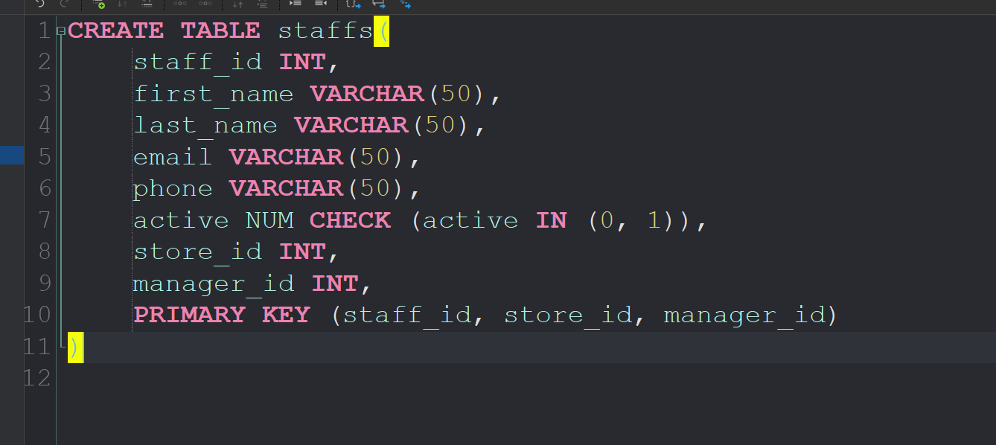
Staffs Table
staff_id → Unique ID of each staff member
first_name → Staff member’s first name
last_name → Staff member’s last name
email → Contact email address of the staff
phone → Staff member’s phone number
store_id → The store where the staff member works
active → Indicates whether the staff member is currently active or not
manager_id → ID of the manager supervising the staff member
The Staffs table contains information about all employees working in the stores. It includes their personal details such as name, email, and phone number, as well as organizational data like store location, manager, and activity status. This table helps track employee performance and manage staff assignments across different stores.

Slide 8
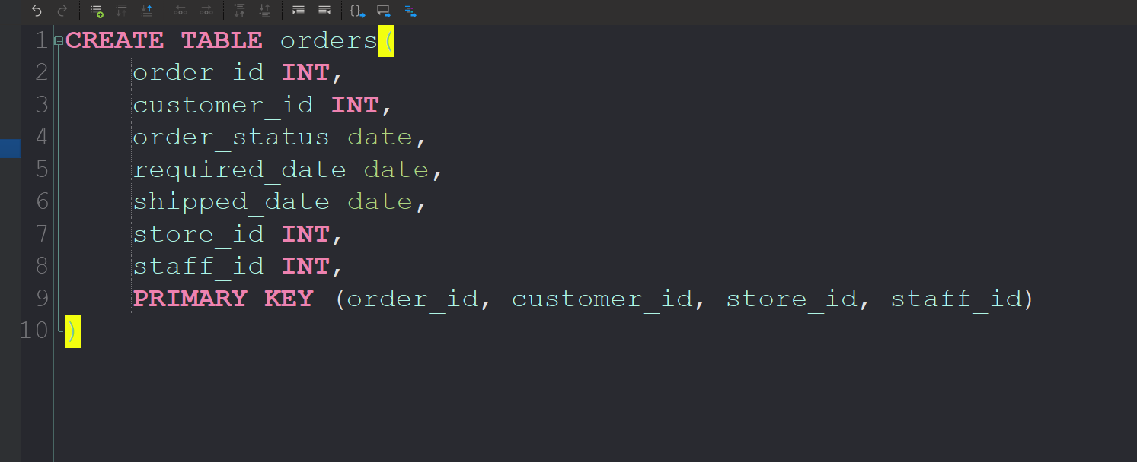
Orders
order_id → Unique identifier for each order
customer_id → ID of the customer who placed the order
order_status → Current status of the order (e.g., pending, shipped, delivered)
required_date → The date by which the customer expects to receive the order
shipped_date → The actual date when the order was shipped
store_id → The store from which the order was processed
staff_id → The staff member responsible for handling the order
The Orders table keeps records of all customer orders made in the system.It includes details such as order dates, shipment information, store location, and the staff member who processed each order.This table is essential for analyzing sales performance, tracking delivery progress, and understanding customer purchasing behavior.

Slide 9
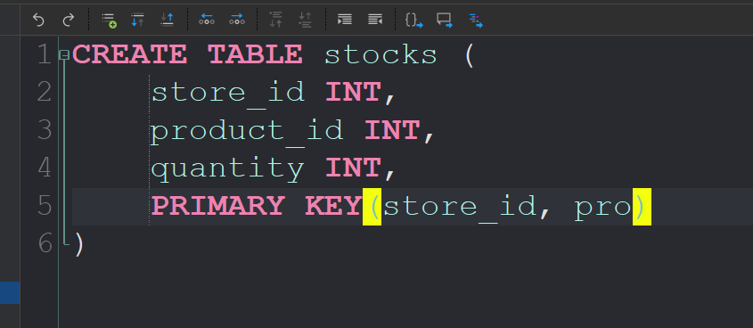
Stocks
store_id → Identifier of the store where the product is kept
product_id → Identifier of the product in stock
quantity → Number of units of that product available in the store
The Stocks table contains information about the quantity of each product available in every store. It helps track inventory levels, identify low-stock products, and ensure that stores are properly supplied. This table is essential for managing stock levels and maintaining smooth product availability across all store locations.

Slide 10
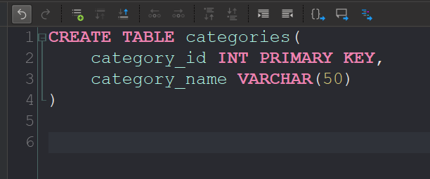
Categories
category_id → Unique identifier for each product category
category_name → Name of the product category
The Categories table stores information about different product categories, such as electronics, clothing, or accessories. It helps organize products into groups, making it easier to analyze sales performance by category and understand which types of products perform best.

Slide 11
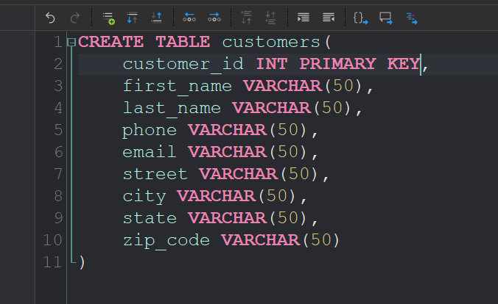
Customers
customer_id → Unique identifier for each customer
first_name → Customer’s first name
last_name → Customer’s last name
phone → Customer’s contact phone number
email → Customer’s email address
street → Customer’s street address
city → City where the customer lives
state → State or region of the
customer
zip_code → Postal code of the customer’s address
The Customers table stores detailed information about all customers, including their personal and contact details as well as address information. It allows businesses to analyze customer demographics, track orders, and identify key markets or locations where sales are strongest.

Slide 12
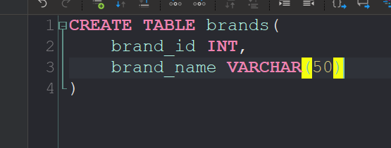
Brands
brand_id → Unique identifier for each brand
brand_name → Name of the brand
The Brands table stores information about different product brands available in the system. It helps organize and categorize products by brand, making it easier to analyze brand performance, compare sales between brands, and understand customer preferences.

Slide 13
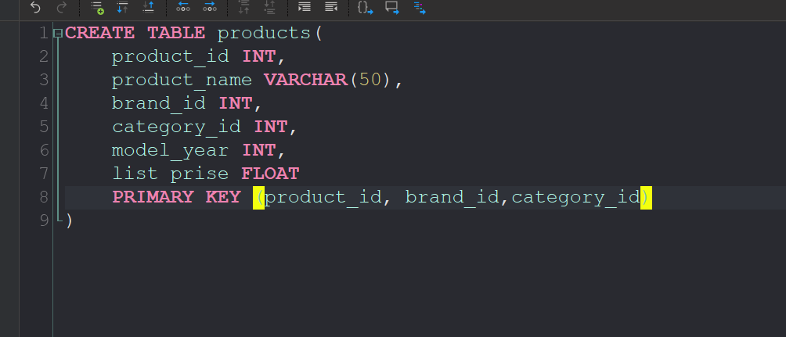
Products
product_id → Unique identifier for each product
product_name → Name of the product
brand_id → Identifier of the brand the product belongs to
category_id → Identifier of the category of the product
model_year → Year the product model was released
list_price → Standard listed price of the product
The Products table contains detailed information about all products, including their names, brands, categories, model years, and prices. It serves as a key source for product-related analysis such as pricing trends, brand performance, and category-based sales comparisons.

Slide 14
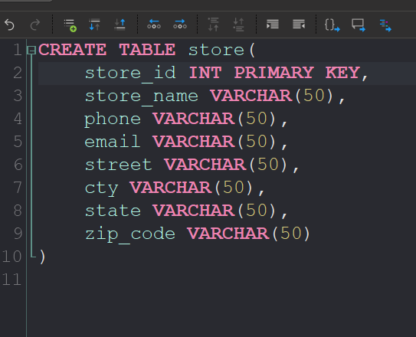
Store
store_id → Unique identifier for each store
store_name → Name of the store
phone → Contact phone number of the store
email → Store’s official email address
street → Street address of the store
city → City where the store is located
state → State or region of the store
zip_code → Postal code of the store’s address
The Stores table stores information about all store locations, including their contact details and addresses. It helps manage store operations, track sales by location, and analyze performance across different regions.

Slide 15
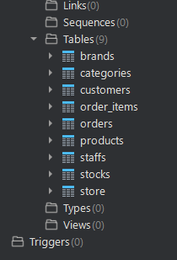
Database Setup Summary
In this part of the project, we successfully collected the dataset and organized it into a SQL database. Each table was created with clearly defined columns, allowing us to build strong relationships between customers, orders, products, and stores. This structure makes it easier to perform accurate data analysis and extract valuable business insights in the next phase.

Slide 16
Dataset Overview
The dataset used in this project represents a complete sales system that connects customers, orders, products, brands, categories, stores, and staff. It contains multiple related tables, which together form a realistic business database. Each table provides a different perspective — from customer information and order details to stock levels and store performance.

Slide 17
Now Let’s start to analyze this data

Slide 18
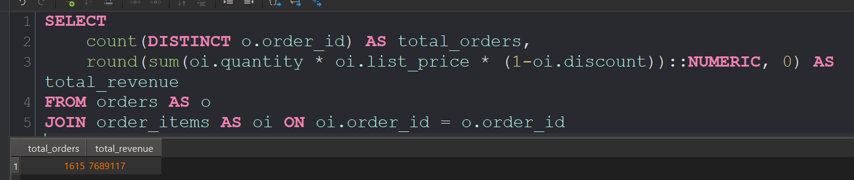
Total Revenue and Number of Orders
In this part of the analysis, we looked at the company’s general sales results. We calculated how many orders were made and how much total money the company earned. The results show that the company had 1,615 orders and made about 7,689,117 in total revenue. These numbers show that sales are strong and that the company has a good number of loyal customers. It also means that the prices and sales methods are working well. Overall, this analysis gives a simple and clear view of how the company is doing financially and helps us understand the business performance better for the next parts of the report.

Slide 19
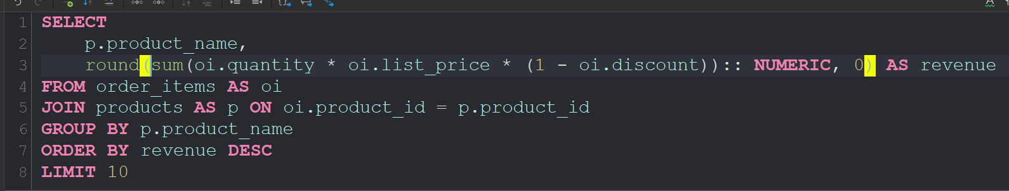
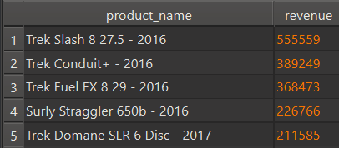
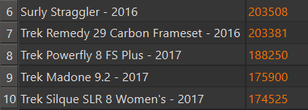
Top 10 Best Selling Products
In this part of the analysis, we looked at the top 10 best-selling products. Overall, the Trek brand achieved the highest sales among all companies. However, when we look at individual products, the Trek Slash 8 27.5 – 2016 had the best sales results, showing that it is a very successful product. After that, we can see Trek Conduit+ – 2016, Trek Fuel EX 8 29 – 2016, and a product from another brand, Surly Straggler 650b – 2016, also performing well. These products are all among the top five. In general, this analysis helps us understand which products are more successful and which ones the company should focus on more in the future.

Slide 20
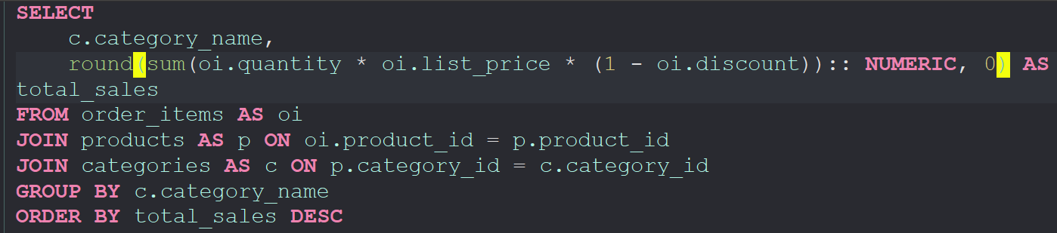
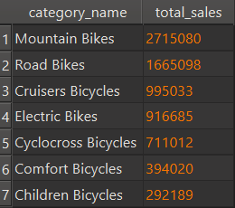
Sales by Category
From this analysis, we can see that each category has a certain level of sales, but they all differ from each other to some extent. Looking at the first place, the Mountain Bikes category has the highest sales. This category achieved a total of 2,715,080 in sales, clearly showing how much stronger it is compared to the others.
In the following positions, we can see Road Bikes, Cruisers Bicycles, and Electric Bikes. Each of these categories has sales of over 900,000, which indicates solid performance as well. Overall, this analysis helps us understand which categories we should focus on more and where we can develop new and different products to increase future sales.

Slide 21
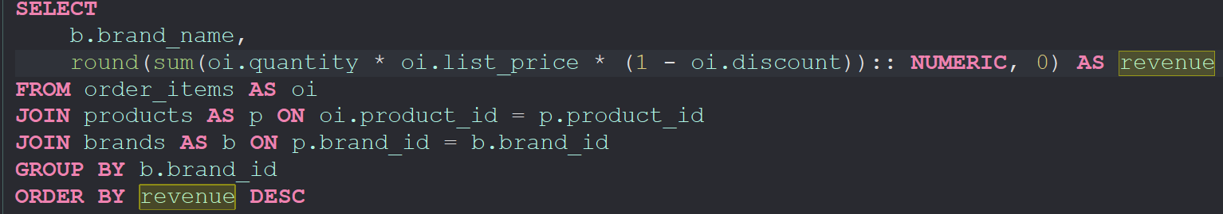
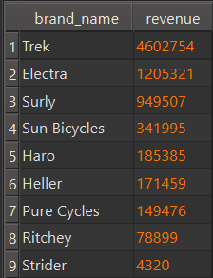
Sales by Brand
Even though some results were visible in the first analysis, it is still important to review the brands separately. Trek had many high-revenue products, and Electra has now moved up to second place, while Surly dropped to third.
However, Trek and Electra lead mainly because they have more products, while Surly achieved impressive results despite having four to five times fewer items.
In conclusion, Surly deserves more focus, as increasing its product range could easily help it reach the same level of success as Electra, and possibly even get close to Trek.

Slide 22
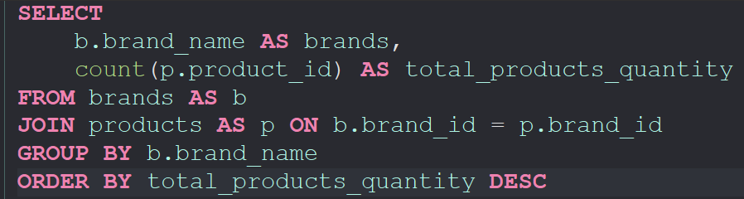
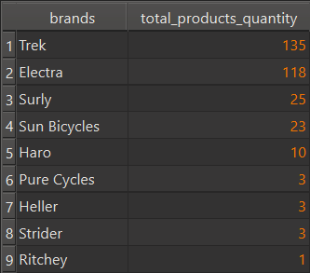
Quantity of products in every brand
From this analysis, it is clear that Trek and Electra have more products than other brands. However, Surly still showed strong performance in total revenue.
The main reason Trek and Electra lead in revenue is their larger product range, while Surly achieved great results despite having 4–5 times fewer products.
In conclusion, Surly deserves more attention, and if it increases its product count, it could reach the same success level as Electra — maybe even get close to Trek.

Slide 23
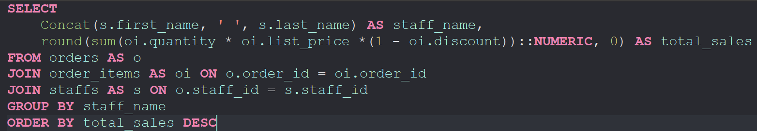
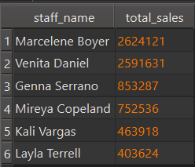
Top Performing Staff
In this section, we analyzed the top-performing staff members and came across some surprising results. Marcelene Boyer and Venita Daniel showed outstanding dominance, each achieving over 2,600,000 in total sales.
In contrast, the next staff members — Genna Serrano and Mireya Copeland — had sales around 750,000, which is significantly lower compared to the two leaders.

Slide 24
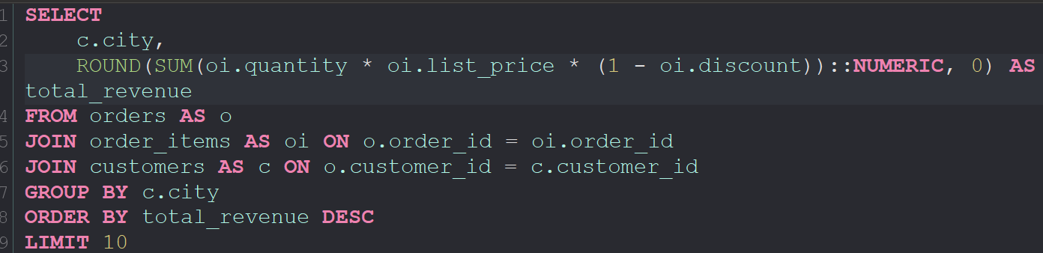
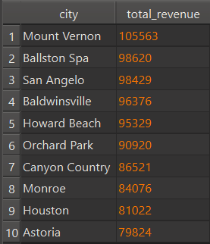
Top 10 cities by their revenue
In this part of the analysis, we looked at the total revenue by city. As shown in the table, Mount Vernon ranks first with a total revenue of 105,563. It is followed by Ballston Spa and San Angelo, both having around 98,000 in total revenue. Overall, the top five cities have very close results, which shows that sales are evenly distributed across these regions. Cities like Houston and Astoria are at the lower end, but they still maintain a stable sales level. This analysis shows that future sales strategies should focus more on cities like Mount Vernon, Ballston Spa, and San Angelo, while additional promotions or campaigns could help boost sales in the lower-performing areas.

Slide 25
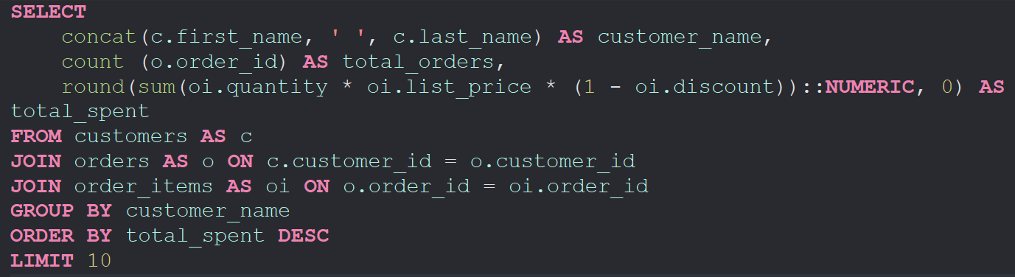
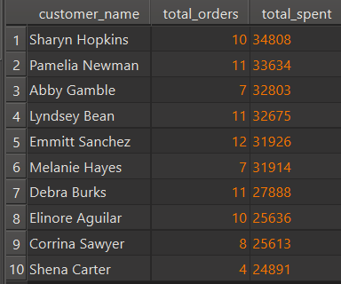
Top 10 customers with high purchases
In this part of the analysis, we focused on the top customers based on their total orders and spending. The data clearly shows that Sharyn Hopkins is the leading customer with 10 orders and a total spending of 34,808. She is followed closely by Pamela Newman and Abby Gamble, both showing strong purchase activity with more than 32,000 in total spent. Overall, we can see that the top five customers have similar spending levels, all above 31,000, which indicates a consistent group of loyal buyers. However, the lower part of the list shows a noticeable drop in spending, meaning that there is potential to increase engagement and sales among less active customers through personalized offers or loyalty programs.

Slide 26
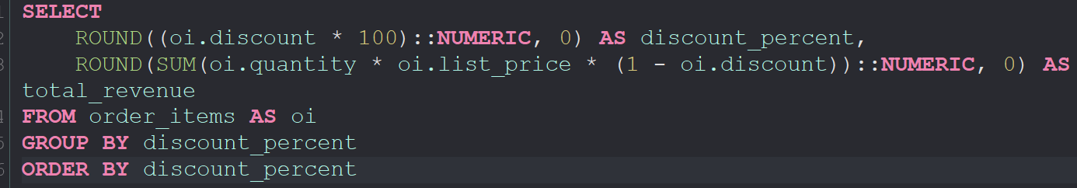
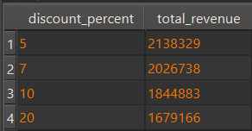
Impact of Discount Rates on Total Revenue
In this part of the analysis, we examined the impact of discounts on total revenue. The results show that lower discounts lead to higher total revenue. For example, a 5% discount generated the highest revenue of 2,138,329, while the 20% discount resulted in the lowest revenue of 1,679,166.
This clearly shows that giving larger discounts does not always increase total sales income. Instead, smaller discounts help maintain profitability while still encouraging customer purchases.

Slide 27
Overall Conclusion
In this project, we analyzed different parts of the company’s sales data, including brands, products, categories, staff, customers, cities, and discounts. The results clearly show that Trek and Electra are the top-performing brands, while Surly, even with fewer products, showed very strong results in total revenue.
Among the staff, Marcelene Boyer and Venita Daniel had the highest sales, showing their strong performance compared to others. The top customers, such as Sharyn Hopkins and Pamela Newman, also played an important role in the company’s total income.
Looking at cities, Mount Vernon had the highest revenue, while other cities like Ballston Spa and San Angelo also performed well. The discount analysis showed that smaller discounts (like 5%) bring higher total revenue, which means large discounts do not always help the company earn more.
Overall, this analysis gives a clear view of the company’s performance and helps to understand which areas need more focus — for example, increasing Surly’s product range, keeping smaller discounts, and motivating customers and staff to maintain strong sales in the future.

Slide 28
This project helped to understand the company’s overall sales performance and identify key areas for improvement.
The analysis showed which brands, staff, and cities performed best, and how discounts affect total revenue.
With the right strategy, the company can continue to grow and improve its results.
Thank you for your attention!

